Slide 1
Copyright Updates
Michele Ballantyne, Associate General Counsel
Julie McAdams, Associate General Counsel

Slide 2
Scope of Copyright Protection
U.S. Constitution – authorized Congress to protect “writings” to increase knowledge.
The Copyright Act protects “original works of authorship fixed in any tangible medium of expression.”
Copyright protects the expression of an idea, not the idea itself

Slide 3

Rights of Copyright Owners
Make Copies
Create derivative works
Distribute the work to the public
Display and/or perform the work publicly
Perform sound recordings by means of a digital transmission (new right)

Slide 4
Fair Use
Purpose and character of the use
Nature of the copyrighted work
Amount and substantiality of the portion used in relation to the copyrighted work as a whole
Effect of the use upon the potential market for or value of the copyrighted work

Slide 5
Purpose and Character of the Use
Favor Fair Use if
Nonprofit
Educational
Personal
Criticism
Commentary
News Reporting
Parody
Otherwise “transformative” use

Slide 6
Purpose and Character of the Use
Weighs Against Fair Use
Commercial
Not transformative

Slide 7
“Imagine”
Creators of the movie “Expelled” used a 15 second excerpt from the song “Imagine,” “Nothing to kill or die for/ And no religion too” over four brief sequences showing children dancing, then a military parade, then Stalin waving. Clip preceded by comments against religion. Is this a transformative fair use?

Slide 8
Nature of the Work
Fair Use
  Fact
  Published
More Protected if
  Creative
  Unpublished

Slide 9
Amount and Substantiality of Portion Used
Fair Use
Small amount
Not the heart
of a work
Appropriate in light of purpose
Not Fair Use
More than small amount
Heart of the work

Slide 10
Effect on the Market
If this kind of use were widespread, what effect would it have on the market for the original or for permissions?

Slide 11
Effect on the Market (cont.)
Get Permission if
  Directly competes with sales of the original?
  Avoids payment for permission in established permissions market?

Slide 12
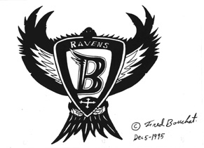
Ravens 1 Shield

Slide 13
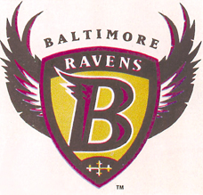
Ravens 2 Shield

Slide 14
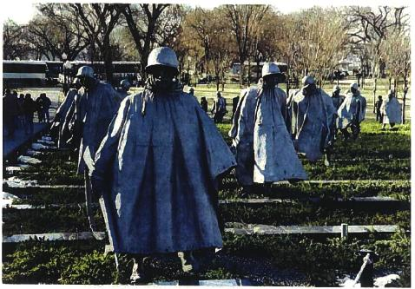
Gaylord – Original Column

Slide 15
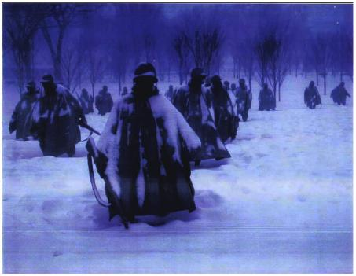
Alli Photograph of the Column

Slide 16
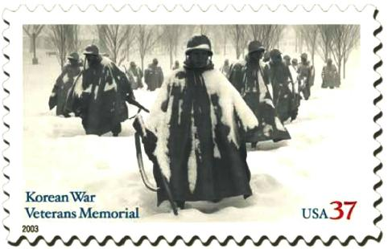
US Postal Stamp

Slide 17
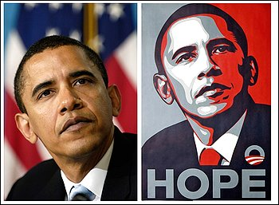
Obama Photo and Poster

Slide 18
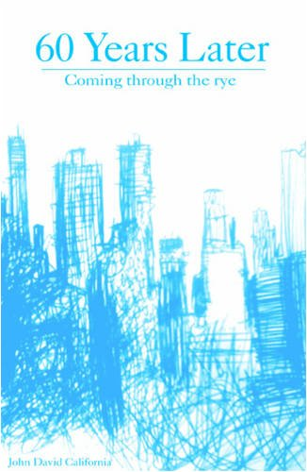
The Catcher in the Rye

Slide 19

Salinger v. Colting
The Catcher in the Rye, original work
60 Years Later Coming Through the Rye
Book billed as “sequel,” Mr. C – Holden Caulfield, similar plot and characters
Trial and appeals court found no fair use

Slide 20
Fair use analysis
Not sufficiently transformative – rejected argument it was a parody or commentary
Original novel creative
Amount used was substantial (characters and plot)
Significant detrimental effect on market for derivatives

Slide 21
University Copying of Copyrighted Works Policy Reg.7-013
Copying of Copyrighted works Reg. 7-013
Performance or display of copyrighted works Reg. 7-014

Slide 22
Online Fair Use Evaluator
http://librarycopyright.net/fairuse

Slide 23
UCLA Streaming Lawsuit
2005 UCLA began converting titles faculty requested into streamable format
Examples: Shakespeare productions for English classes; foreign language films for linquistic and foreign language classes
Password protected sites; enrolled students; via UCLA intranet; no up- or downloading

Slide 24
AIME and AVP Claims
Copyright violation by copying films purchased from Plaintiffs, then streaming
AIME and AVP offer streaming licenses
Lawsuit filed December 2010

Slide 25
UCLA Arguments
Fair Use
  Educational use – purpose of teaching rather than entertainment
  Nature of work?
  Amount used?
  Because can show same film in classroom, no real market harm

Slide 26
Face-to-face teaching exception
  Classroom or similar place devoted to instruction
TEACH Act distance learning
  Are these “reasonable and limited portions”?
  Are they all “nondramatic literary or musical works”?
  Are they works marketed for distance ed?

Slide 27
Georgia State E-Reserves
Cambridge and Oxford Presses filed suit alleging use of electronic systems to reproduce and distribute excerpts from copyrighted works to students – injunctive relief
New Georgia State copyright policy 2009 – instructor must complete Fair Use Checklist; if conclude is fair use, can use e-reserve.

Slide 28
Court ruling on motions for summary judgment October 2010 – record did not establish whether the new policy encourages the proper application of fair use.
Plaintiffs will need to show that new 2009 “Policy resulted in ongoing and continuous misuse of fair use defense.”

Slide 29
Digital Millennium Copyright Act
Prohibits circumvention of certain technological measures employed by or on behalf of copyright owners to protect their works

Slide 30
Exemptions to the DMCA
Register of Copyrights and Library of Congress charged to balance copyright protections and the public’s ability to make non-infringing uses
If scrambling software makes it too difficult to make non-infringing uses, an exemption will be granted (evaluated every three years)

Slide 31
Short portions of motion pictures (DMCA exemption)
What
  Motion pictures (not video games or slide presentations)
  Contained in a college or university library

Slide 32
Short portions of motion pictures
(DMCA exemption)
Why
  Motion picture used for the purpose of criticism & comment
  Reasonable belief that circumvention is necessary to fulfill the purpose of the use
    Educational uses
    Documentary filmmaking
    Non-commercial videos

Slide 33
Short portions of motion pictures
(DMCA exemption)
Who
  College or university professors
  Film & media studies students

Slide 34
Installation of third-party software on smart phones
(DMCA exemption)
Circumvention of the technological measures that prevent third-party software applications from being installed on smart phones is permitted under fair-use
Consistent with congressional interests in interoperability

Slide 35
Installation of third-party software on smart phones
(DMCA exemption)
Fair-use
  Purpose: private, non-commercial use
  Nature of the work: customary for third-party programs to interoperate
  Portion taken: unauthorized derivative work, but small amount modified (1/160,000th) undermines the importance of this factor
  Effect on the market: likely to increase, not decrease sales

Slide 36
“Unlocking” smart phones
(DMCA exemption)
An individual owner of a smart phone is allowed to “unlock” his/her smart phone so that it can be used on the wireless network of the owner’s choice
This does not apply to “bulk resellers” who purchase new smart phones for resale

Slide 37
Many patient intake or assessment questionnaires require permission
Use standardized tests and assessments only with permission from the copyright holder (or the company acting on his/her behalf)
If you are unsure of whether a test or assessment you wish to use is copyrighted, find out prior to using it (the Office of General Counsel can help determine if a work is copyrighted)

